Slide 1

Quality of Red Wine

Slide 2
Group No. 11
Members:
Abhishek Muthange 405A004
Hrishikesh Jadhav 405C011
Akash Pawar 405C026
Pushkar Dounde 405A023

Slide 3
Abstract
Wine classification is a difficult task since taste is the least understood of the human senses. A good wine quality prediction can be very useful in the certification phase, since currently the sensory analysis is performed by human tasters, being clearly a subjective approach. An automatic predictive system can be integrated into a decision support system, helping the speed and quality of the performance.

Slide 4
Objectives
The objectives of this project are as follows:
To experiment with different types of algorithms i.e. Classification, Clustering algorithms etc, methods to see which yields the highest accuracy.
To determine which features are the most indicative of a good quality wine.

Slide 5
Input
For this project, We have used dataset related to red wine quality according to our needs to build classification as well as clustering models to predict whether a particular red wine is “good quality” or not. Each wine in this dataset is given a “quality” score between 0 and 10. For the purpose of this project, We then converted the output to a binary output where each wine is either “good quality” (a score of 7 or higher) or not (a score below 7).
The quality of a wine is determined by 11 input variables mentioned on the next slide.

Slide 6
Dataset Screenshot
Features Variables
fixed acidity | volatile acidity | citric acid | residual sugar | chlorides | free sulfur dioxide | total sulfur dioxide | density | pH | sulphates | Alcohol | Quality
7.4 | 0.7 | 0 | 1.9 | 0.076 | 11 | 34 | 0.9978 | 3.51 | 0.56 | 9.4 | 5
7.8 | 0.88 | 0 | 2.6 | 0.098 | 25 | 67 | 0.9968 | 3.2 | 0.68 | 9.8 | 5
7.8 | 0.76 | 0.04 | 2.3 | 0.092 | 15 | 54 | 0.997 | 3.26 | 0.65 | 9.8 | 5
11.2 | 0.28 | 0.56 | 1.9 | 0.075 | 17 | 60 | 0.998 | 3.16 | 0.58 | 9.8 | 6
7.4 | 0.7 | 0 | 1.9 | 0.076 | 11 | 34 | 0.9978 | 3.51 | 0.56 | 9.4 | 5
7.4 | 0.66 | 0 | 1.8 | 0.075 | 13 | 40 | 0.9978 | 3.51 | 0.56 | 9.4 | 5
7.9 | 0.6 | 0.06 | 1.6 | 0.069 | 15 | 59 | 0.9964 | 3.3 | 0.46 | 9.4 | 5
7.3 | 0.65 | 0 | 1.2 | 0.065 | 15 | 21 | 0.9946 | 3.39 | 0.47 | 10 | 7
7.8 | 0.58 | 0.02 | 2 | 0.073 | 9 | 18 | 0.9968 | 3.36 | 0.57 | 9.5 | 7
7.5 | 0.5 | 0.36 | 6.1 | 0.071 | 17 | 102 | 0.9978 | 3.35 | 0.8 | 10.5 | 5
6.7 | 0.58 | 0.08 | 1.8 | 0.097 | 15 | 65 | 0.9959 | 3.28 | 0.54 | 9.2 | 5

Slide 7
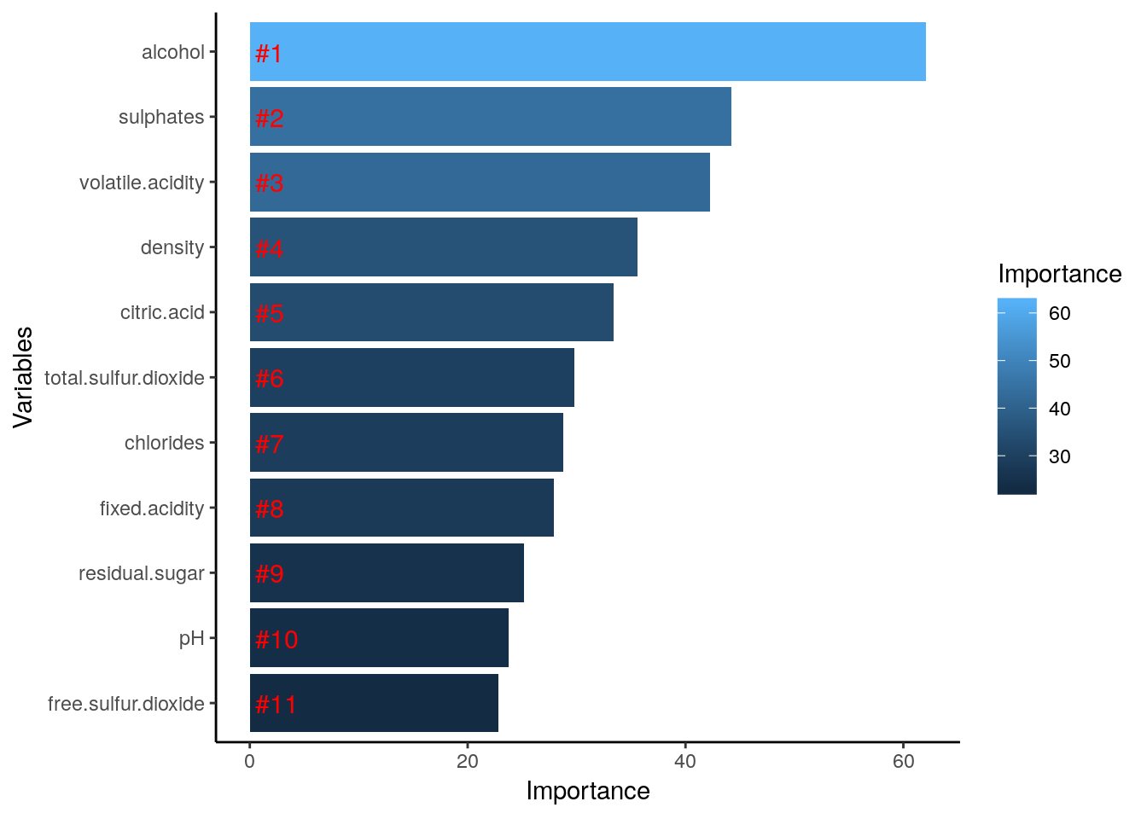
Input Features
The quality of a wine is determined by 11 input variables:
Fixed acidity
Volatile acidity
Citric acid
Residual sugar
Chlorides
Free sulphur dioxide
Total sulphur dioxide
8. Density
pH
Sulphates
Alcohol

Slide 8
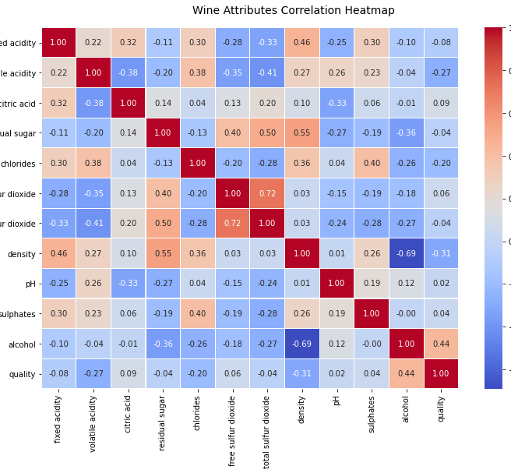
Correlation Heatmap

Slide 9
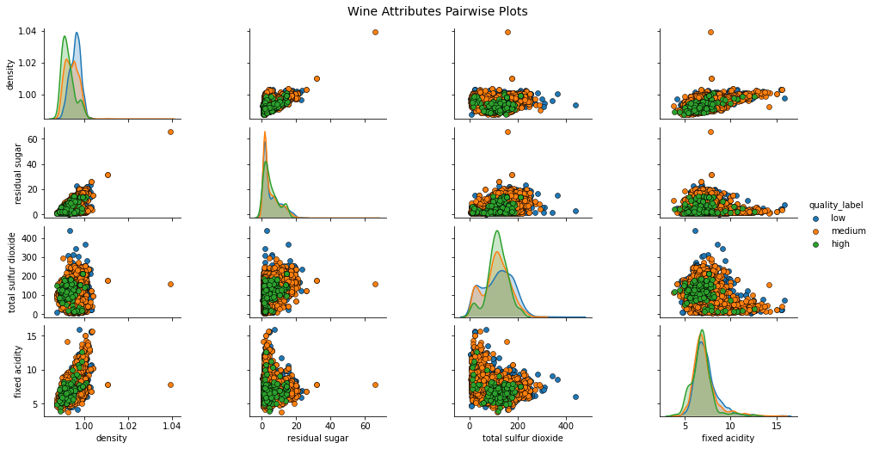
Pair-wise Scatter Plot

Slide 10
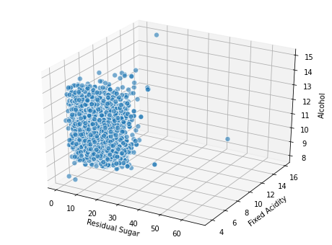
Visualizing three continuous Attributes

Slide 11
Algorithms used in the project
1. K Nearest Neighbour (Classification):
KNN works by finding the distances between a query and all the examples in the data, selecting the specified number of examples (K) closest to the query, then votes for the most frequent label (in the case of classification) or averages the labels (in the case of regression).
2. K-means (Clustering):
The k-means clustering algorithm attempts to split a given anonymous data set (a set containing no information as to class identity) into a fixed number (k) of clusters. ... The resulting classifier is used to classify (using k = 1) the data and thereby produce an initial randomized set of clusters.

Slide 12
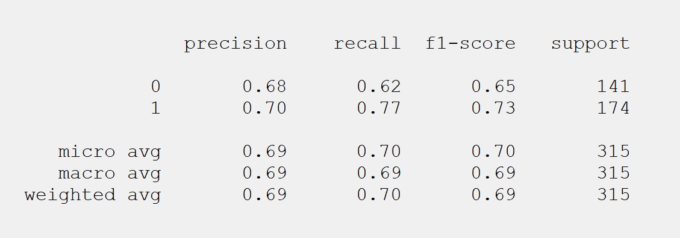
K nearest neighbors Classification Report

Slide 13
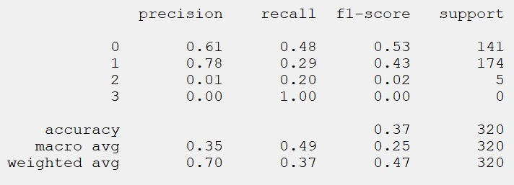
K-means clustering Classification Report

Slide 14
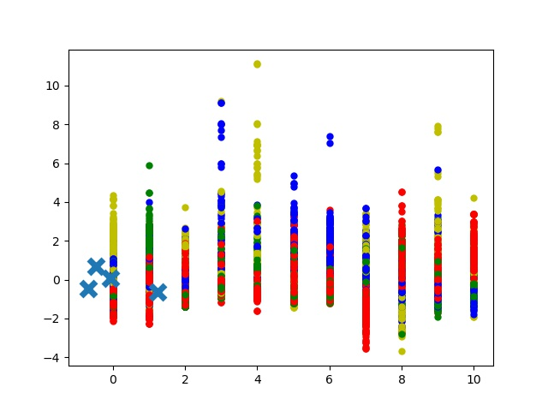
K-means graph

Slide 15
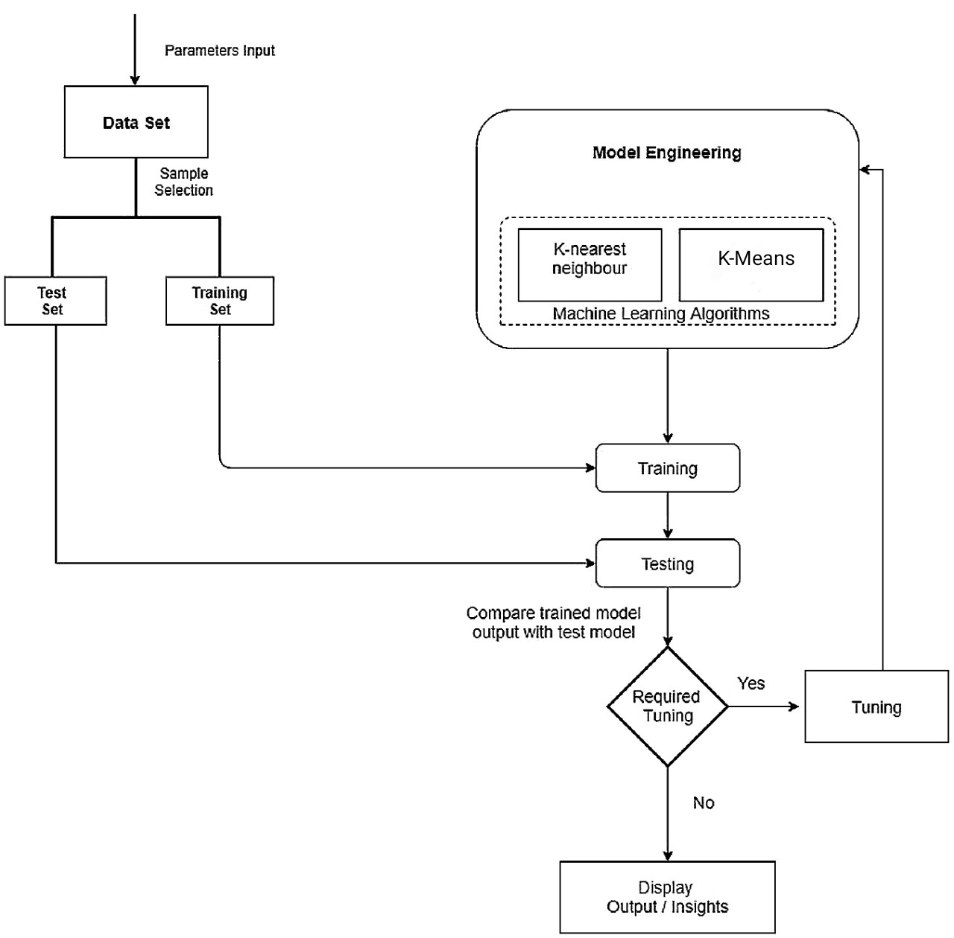
Program Flow

Slide 16
Unit Testing
A unit test is a piece of code which executes a specific functionality in the code to be tested and asserts a certain behaviour or state. The percentage of code which is tested by unit tests is typically called test coverage. A unit test targets a small unit of code. e.g. a method or a class
In this project unit testing has been done for accuracy on KNN and K-means algorithms.

Slide 17
Software Requirement
Software Used:
Vscode
Jupyter Notebook
Libraries Used:
PyQt5
Scikit Learn
Pandas
Json
Matplotlib
Numpy

Slide 18
Conclusion
By looking into the details, we can see that good quality wines have higher levels of alcohol on average, have a lower volatile acidity on average, higher levels of sulphates on average, and higher levels of residual sugar on average.

Slide 19
Thank You!

